Slide 1
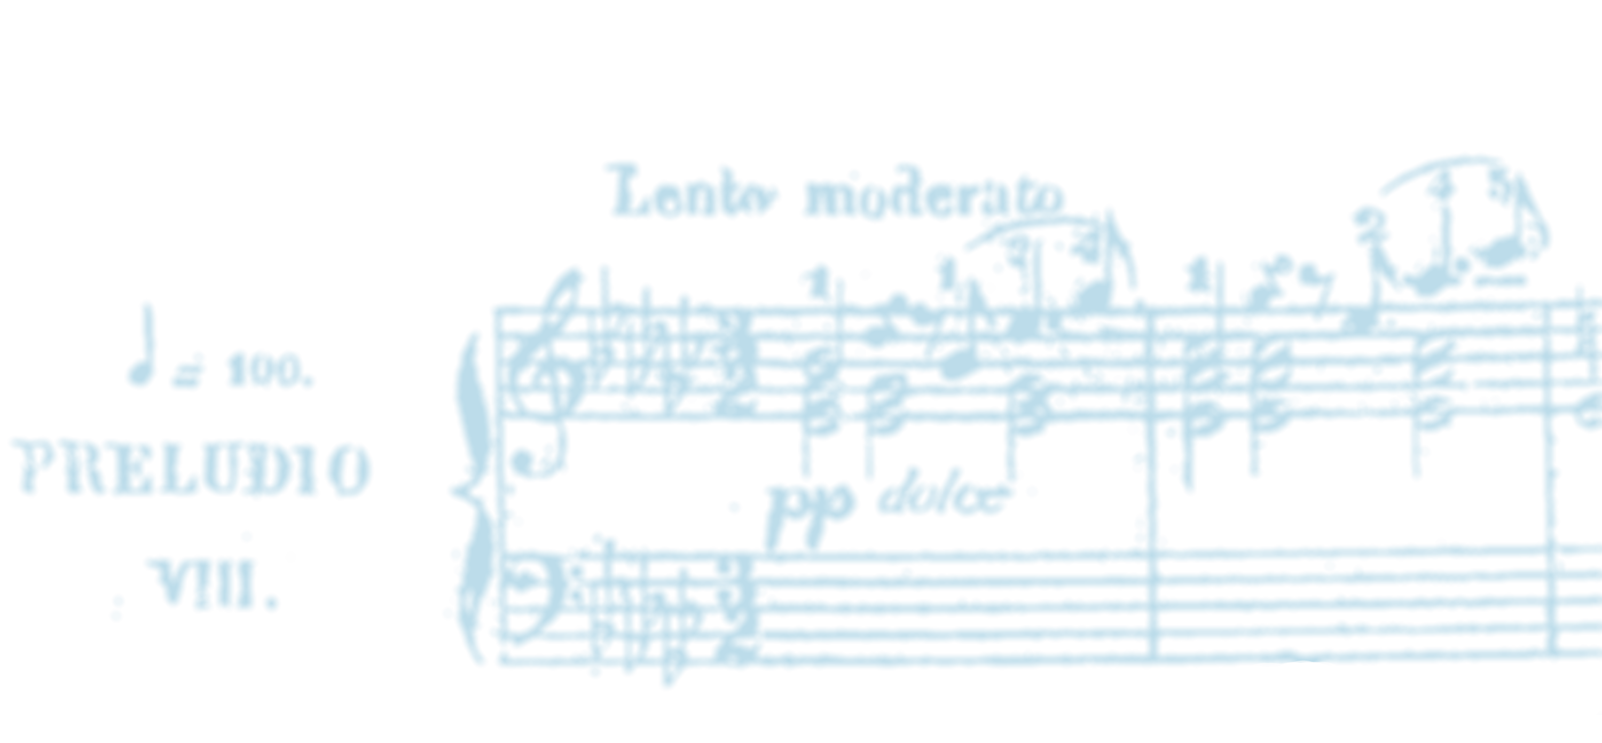




Echos du temps passé
Artistic Research @ Kristiania University of Oslo
March 17-18, 2025
Deconstruction of authority: Seeking truth in Historical Editions & Performances of the Baroque Keyboard Music
Nicholas Cornia
Viktor Lazarov
Notes:
Viktor plays a short extract before the starting of the presentation.

Slide 2
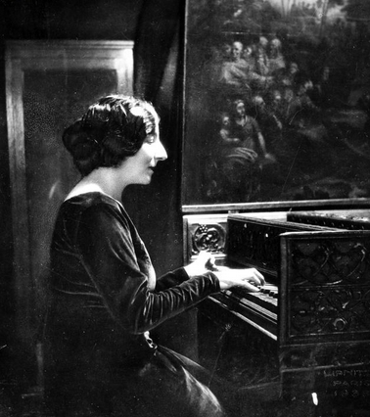
Theoretical & Artistic Framework
It would be wrong to pretend that there is only one interpretation, the right one.
Wanda Landowska
Echos du temps passé - AR@K symphosium 17-18 March 2025
Notes:
Questioning the concept of the "work": instead of seeking the right version, according to the composer's will, we should embrace the plurality of interpretations around it.
Our project wishes to illustrate this inherent, and exiting, plurality by considering two iconic keyboard works by J.S. Bach and Domenico Scarlatti.
We clarify this is a work in progress, and we are working on publish an extended article about our results.
P.s. See "decostruction of aura" by Walter Benjamin and Derrida, against the authoritative school of Hisher (Validity of Interpretation)

Slide 3
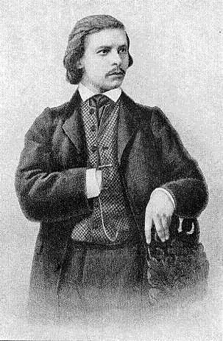
Theoretical & Artistic Framework
Postmodernity
Plurality
Reappropriation
Re-evaluating authenticity
Karl Tausig
Echos du temps passé - AR@K symphosium 17-18 March 2025
Notes:
Questioning the concept of the "work": instead of seeking the right version, according to the composer's will, we should embrace the plurality of interpretations around it.
Our project wishes to illustrate this inherent, and exiting, plurality by considering two iconic keyboard works by J.S. Bach and Domenico Scarlatti.
We clarify this is a work in progress, and we are working on publish an extended article about our results.
P.s. See "decostruction of aura" by Walter Benjamin and Derrida, against the authoritative school of Hisher (Validity of Interpretation)

Slide 4
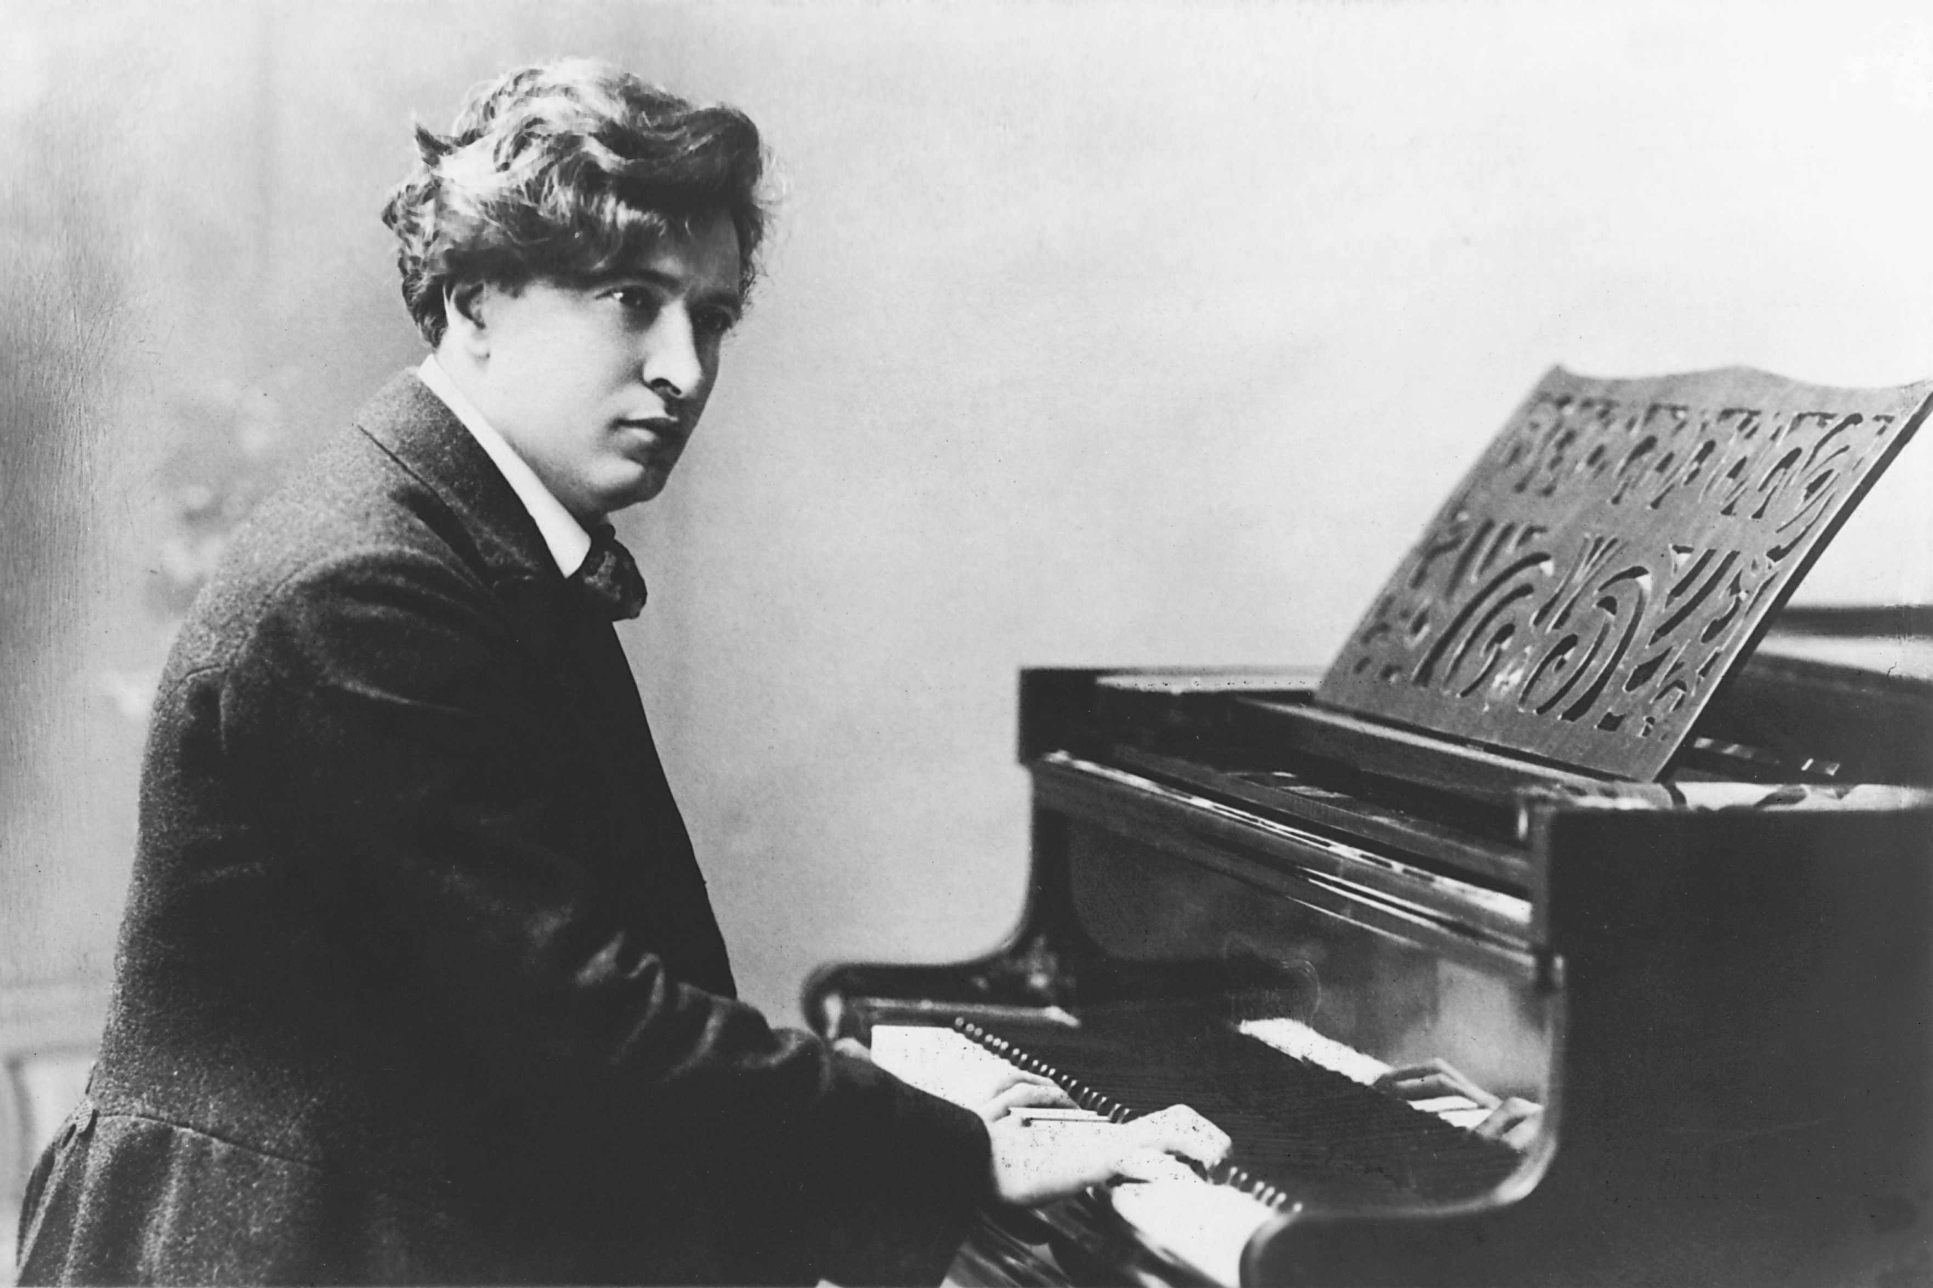
Motivation
Ancient Régime music
Scarcity of performance indications
Oral tradition
Performance practice sediments
Recordings
Oral traditions
Editions
Ferruccio Busoni
Echos du temps passé - AR@K symphosium 17-18 March 2025
Notes:
Questioning the concept of the "work": instead of seeking the right version, according to the composer's will, we should embrace the plurality of interpretations around it.
Our project wishes to illustrate this inherent, and exiting, plurality by considering two iconic keyboard works by J.S. Bach and Domenico Scarlatti.
We clarify this is a work in progress, and we are working on publish an extended article about our results.
P.s. See "decostruction of aura" by Walter Benjamin and Derrida, against the authoritative school of Hisher (Validity of Interpretation)

Slide 5
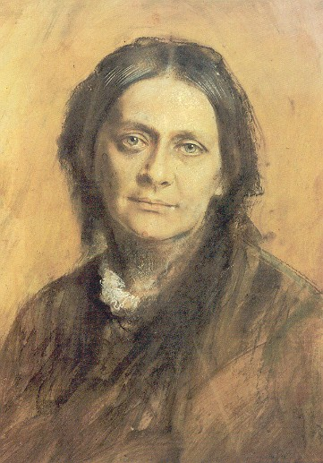
Aims
Stylistic time travel
Comparative study
Informing artistic research process
Computational musicology
Clara Schumann
Echos du temps passé - AR@K symphosium 17-18 March 2025
Notes:
Questioning the concept of the "work": instead of seeking the right version, according to the composer's will, we should embrace the plurality of interpretations around it.
Our project wishes to illustrate this inherent, and exiting, plurality by considering two iconic keyboard works by J.S. Bach and Domenico Scarlatti.
We clarify this is a work in progress, and we are working on publish an extended article about our results.
P.s. See "decostruction of aura" by Walter Benjamin and Derrida, against the authoritative school of Hisher (Validity of Interpretation)

Slide 6
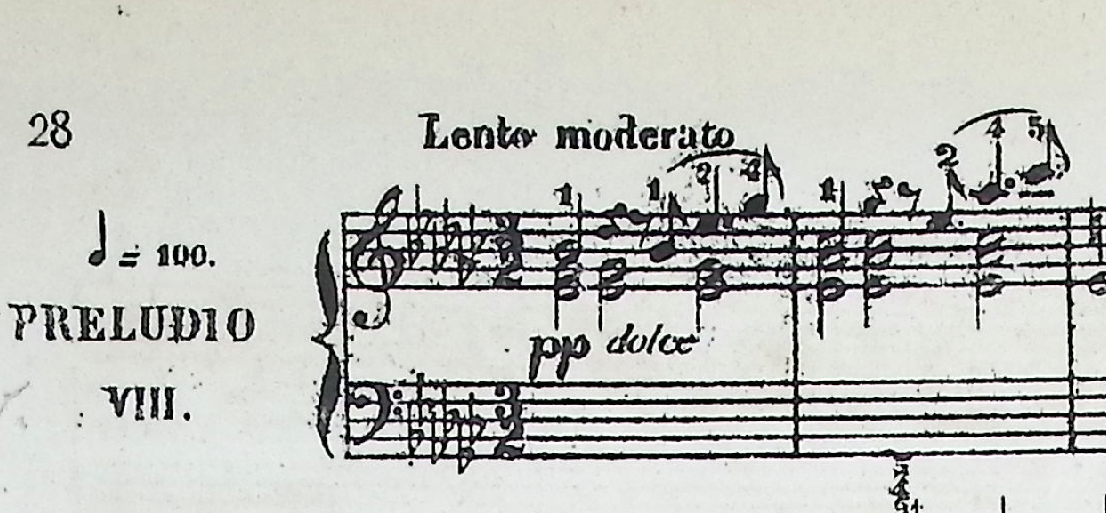
Corpus
Prelude N. 8 in Eb minor, BWV 853
Well-Tempered Clavier, Book I
Sonata in D minor, K.9
Considerations:
Viktor's repertoire
Miniature pieces
Ecosystem of editions
Echos du temps passé - AR@K symphosium 17-18 March 2025
Notes:
For the romantici, the keyboard music of Bach and Scarlatti have been a inexaustable source of inspiration and have been part of the training of generation of pianists around Europe.

Slide 7

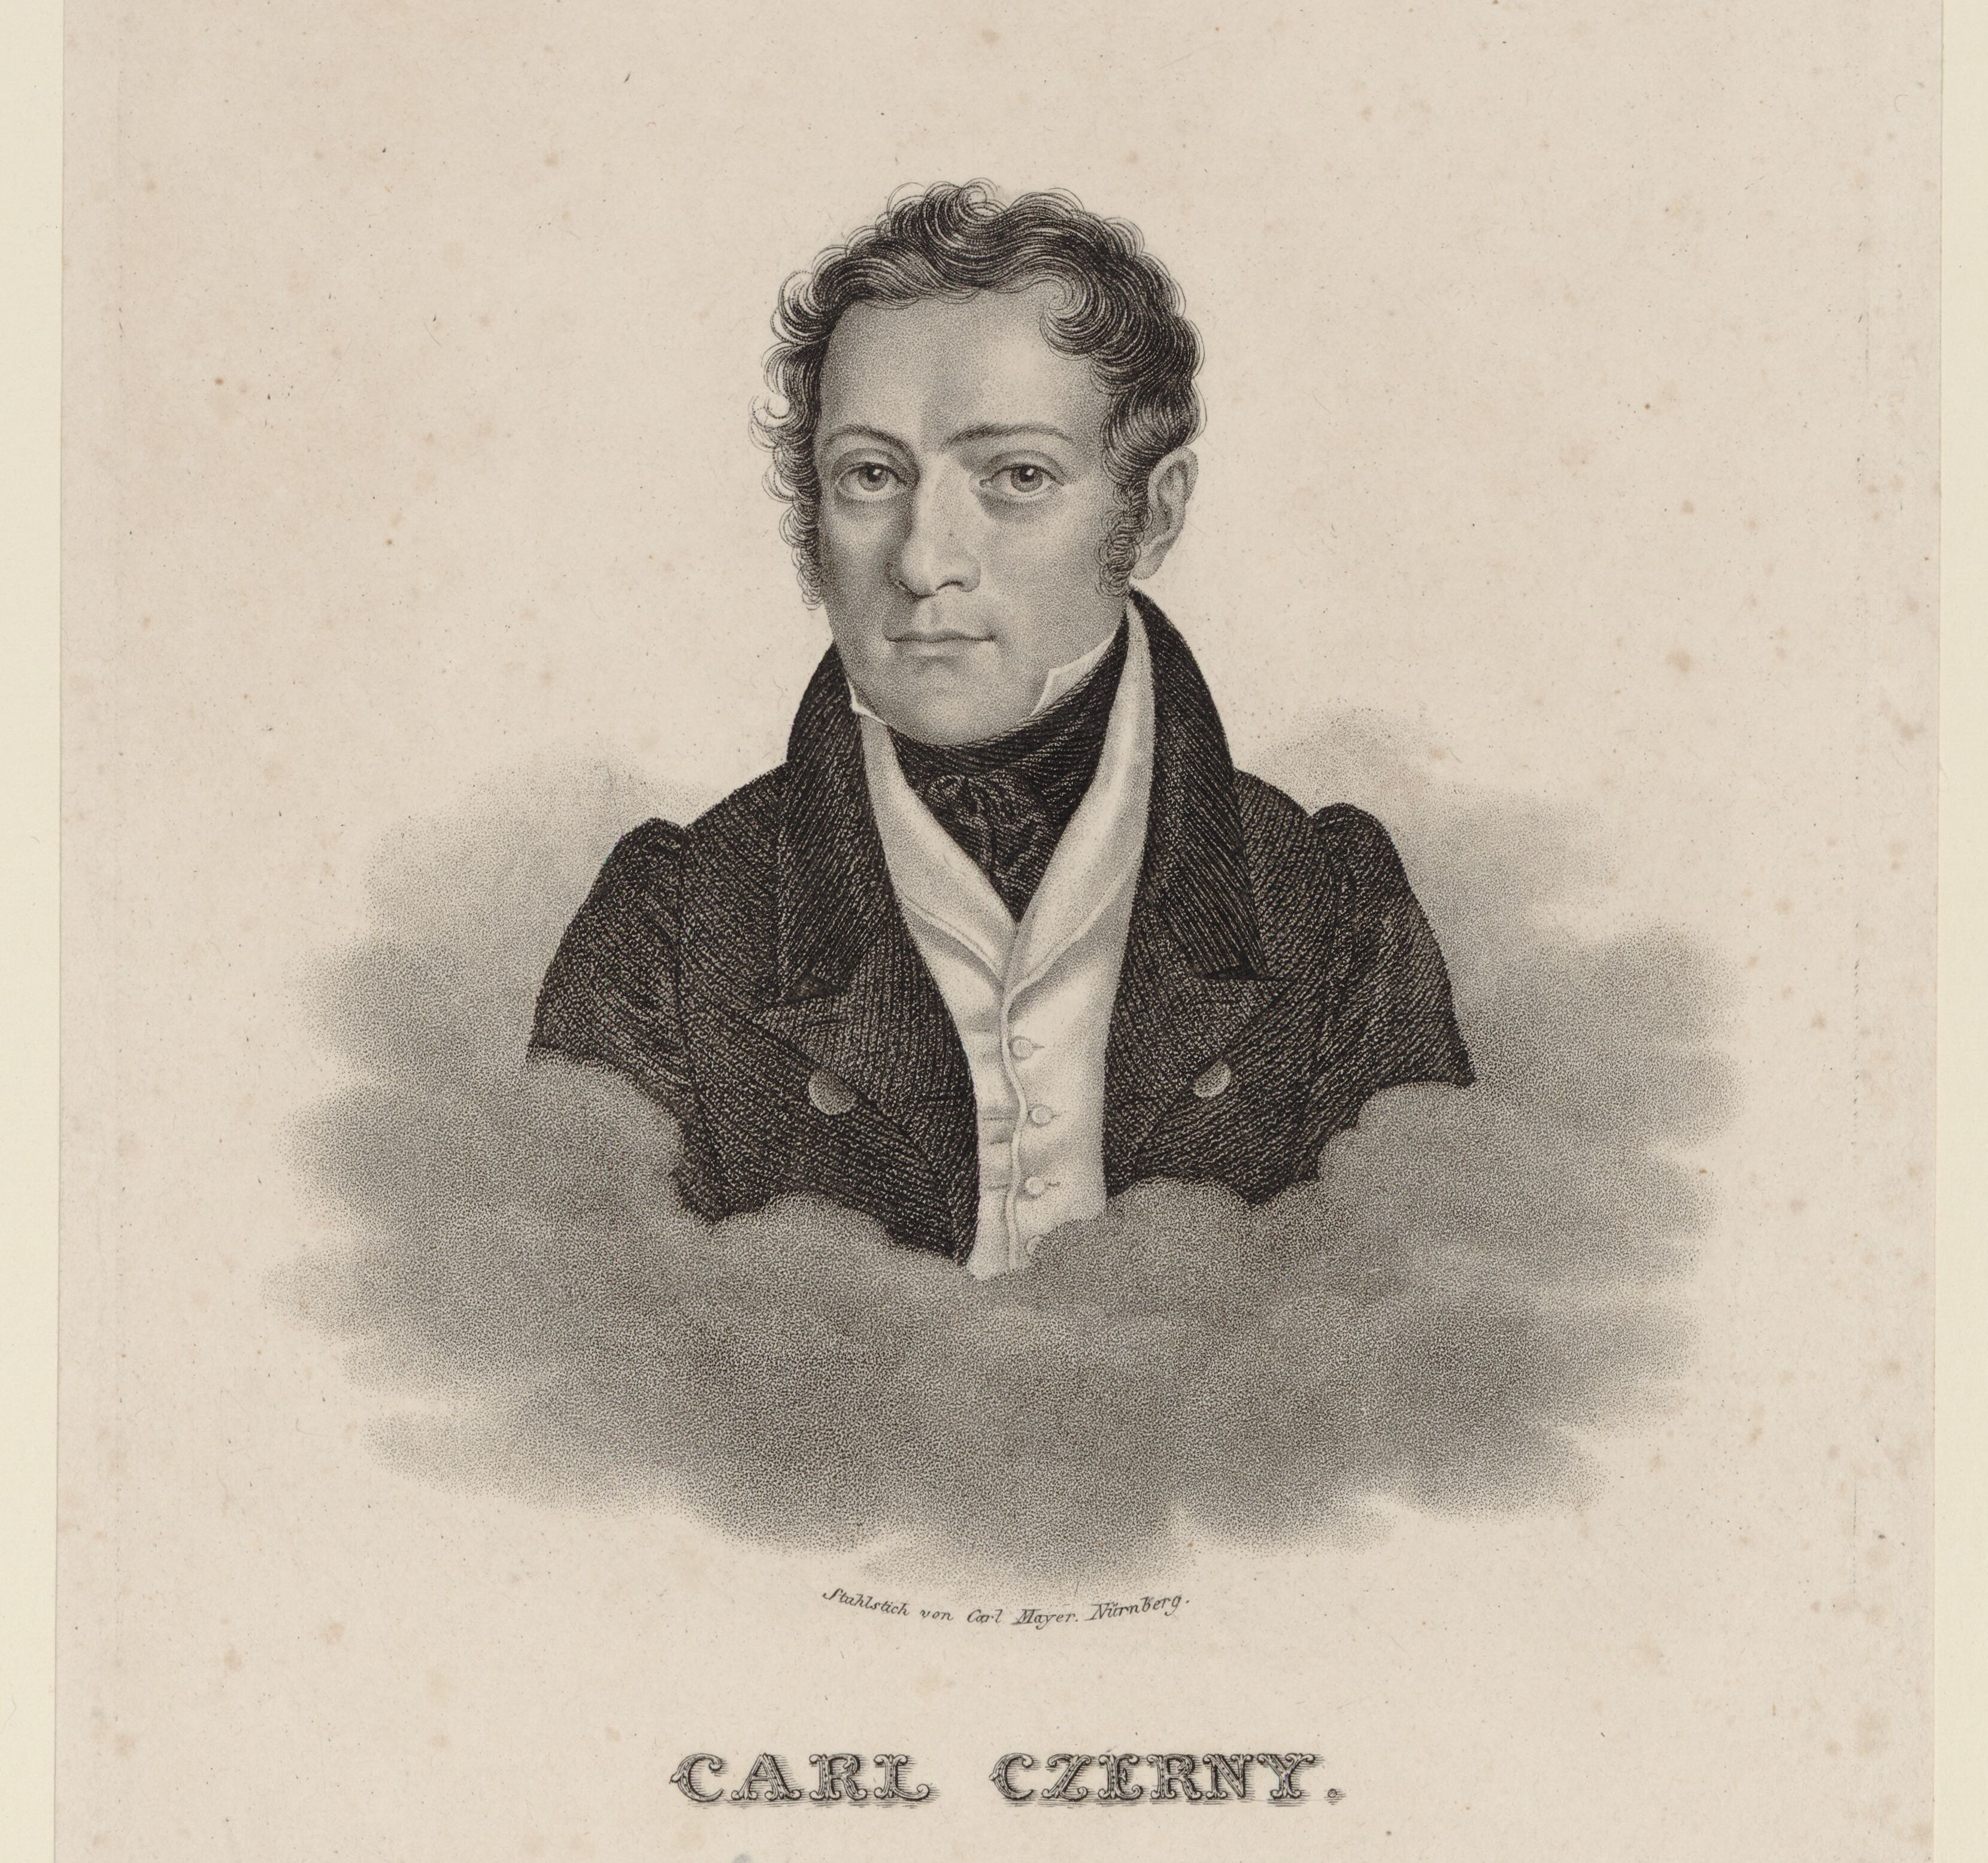
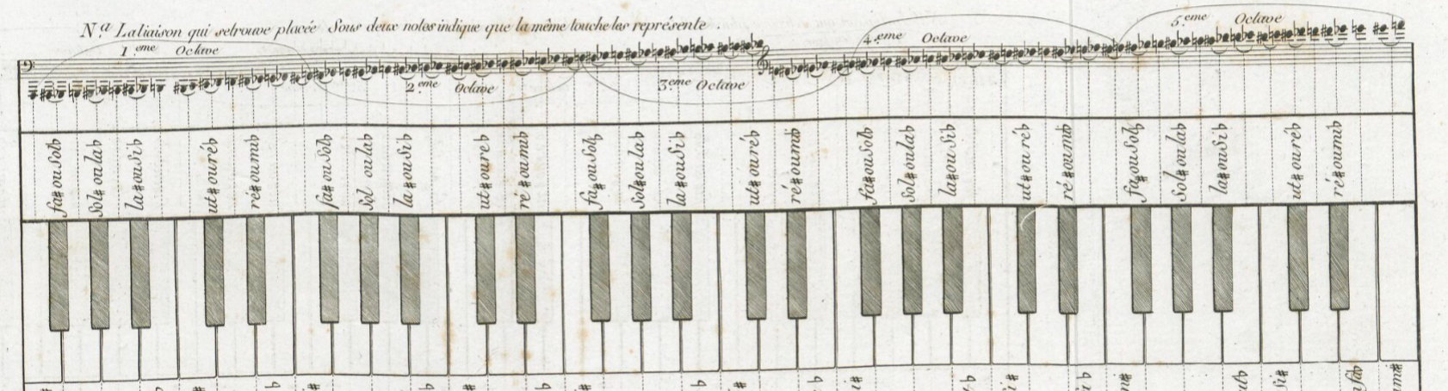
Analysis Overview
The GitHub repository
Music XML analysis with Music21 Python library
Historical editions
MIDI Disklavier performances
Live recorded performances
Echos du temps passé - AR@K symphosium 17-18 March 2025
Notes:
Here comes some brief discussion about the analysis of the MusicXML transcriptions and the MIDI files from the Disklavier

Slide 8
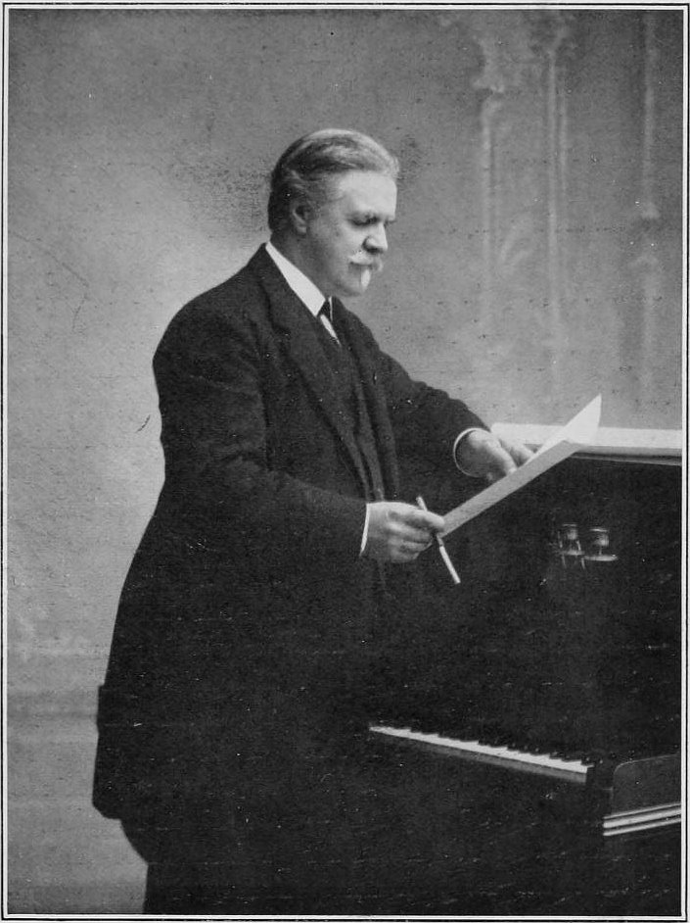
Analysis: editions
Digital transcription of performance instructions
MusicXML and MEI encoding
Computational analysis
Music21 Python library
CSV tables
Vincent d'Indy
Echos du temps passé - AR@K symphosium 17-18 March 2025
Notes:
Here comes some brief discussion about the analysis of the MusicXML transcriptions and the MIDI files from the Disklavier

Slide 9
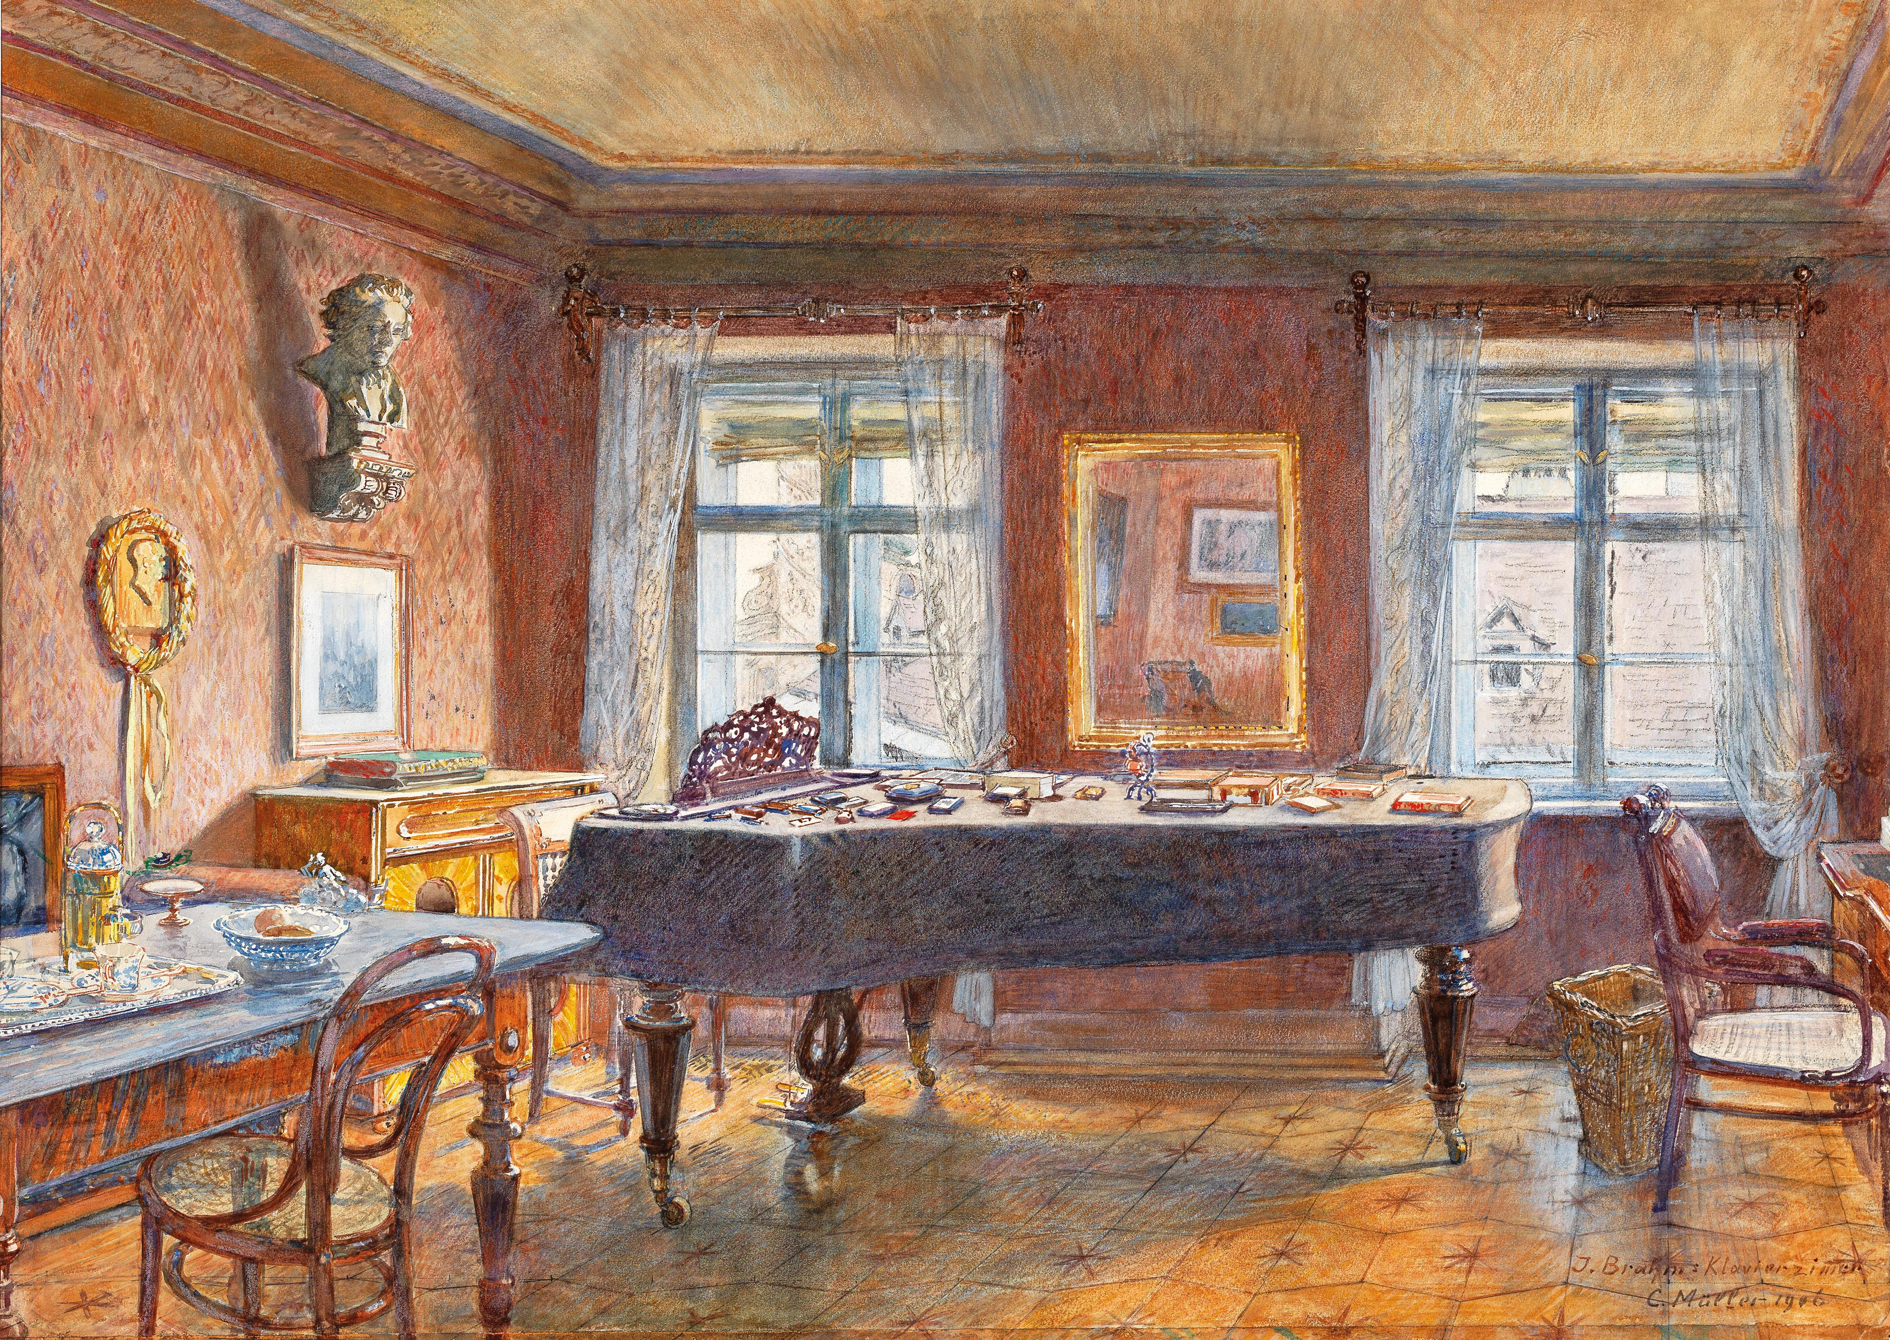
Analysis: performance
Yamaha Disklavier DC7X (Université de Montréal)
Quantitative:
MIDI data
Tempo & Dynamics graphs (Clara) & Matlab
Qualitative:
Self-reflection and session log
Echos du temps passé - AR@K symphosium 17-18 March 2025
Notes:
Here comes some brief discussion about the analysis of the MusicXML transcriptions and the MIDI files from the Disklavier

Slide 10
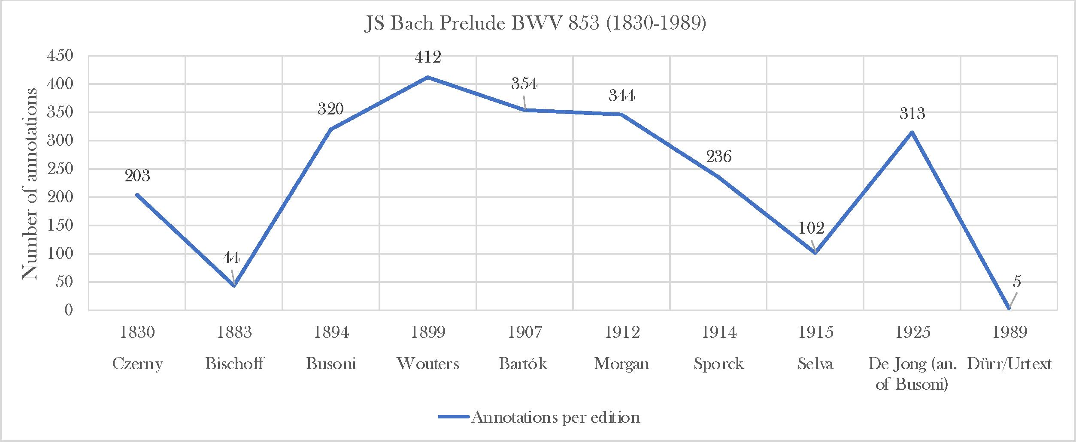
JS Bach Editions
*Total = slurs + dynamics + expression + tempo + articulation + fingering
Echos du temps passé - AR@K symphosium 17-18 March 2025
Notes:
Here comes the quantitative discussion. Let's consider one or two parameters for the Bach and Scarlatti and digress from them.

Slide 11
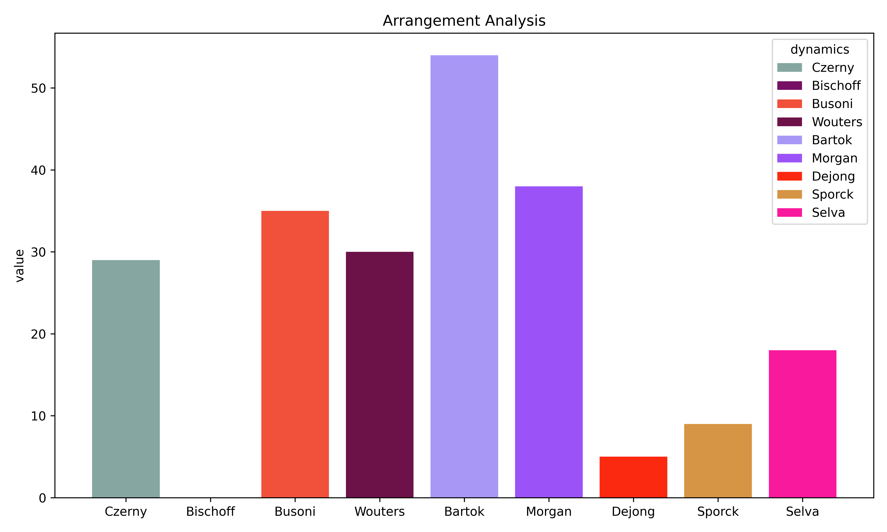
Dynamics : JS Bach
Echos du temps passé - AR@K symphosium 17-18 March 2025
Notes:
Here comes the quantitative discussion. Let's consider one or two parameters for the Bach and Scarlatti and digress from them.

Slide 12
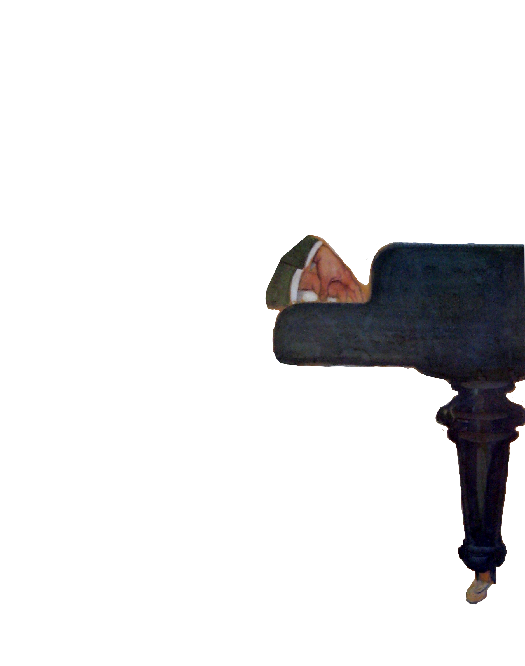
J.S. Bach Prelude in E-flat minor BWV 853
Echos du temps passé - AR@K symphosium 17-18 March 2025
Notes:
Questioning the concept of the "work": instead of seeking the right version, according to the composer's will, we should embrace the plurality of interpretations around it.
Our project wishes to illustrate this inherent, and exiting, plurality by considering two iconic keyboard works by J.S. Bach and Domenico Scarlatti.
We clarify this is a work in progress, and we are working on publish an extended article about our results.
P.s. See "decostruction of aura" by Walter Benjamin and Derrida, against the authoritative school of Hisher (Validity of Interpretation)

Slide 13
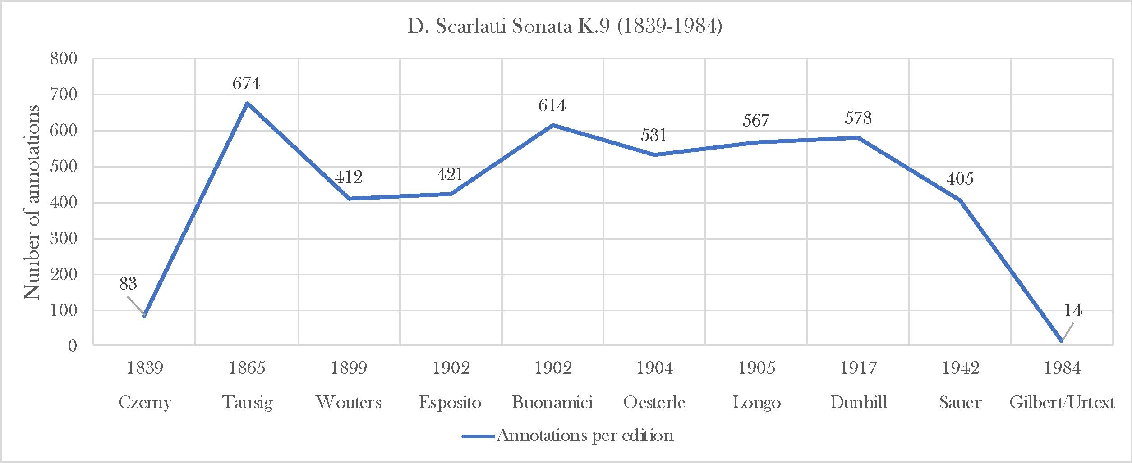
D Scarlatti Editions
*Total = slurs + dynamics + expression + tempo + articulation + fingering
Echos du temps passé - AR@K symphosium 17-18 March 2025
Notes:
Here comes the quantitative discussion. Let's consider one or two parameters for the Bach and Scarlatti and digress from them.

Slide 14
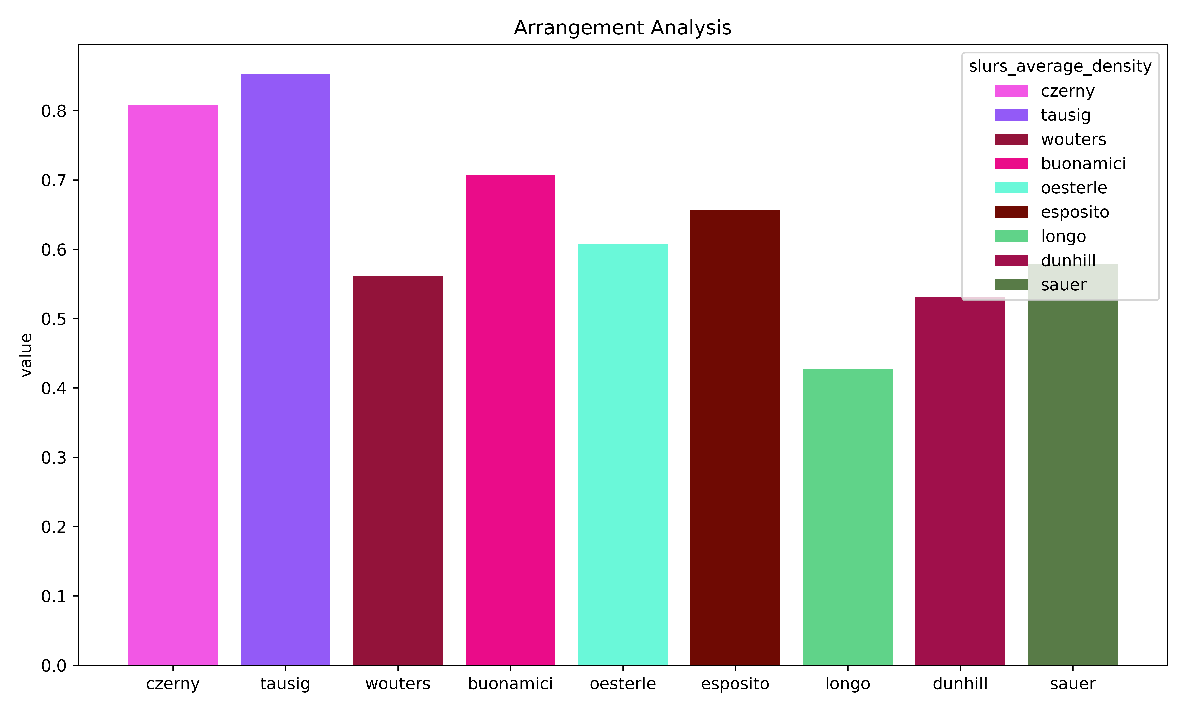
Slur density: D Scarlatti
Echos du temps passé - AR@K symphosium 17-18 March 2025
Notes:
Here comes the quantitative discussion. Let's consider one or two parameters for the Bach and Scarlatti and digress from them.

Slide 15
D. Scarlatti Sonata in D minor K.9
Echos du temps passé - AR@K symphosium 17-18 March 2025
Notes:
Questioning the concept of the "work": instead of seeking the right version, according to the composer's will, we should embrace the plurality of interpretations around it.
Our project wishes to illustrate this inherent, and exiting, plurality by considering two iconic keyboard works by J.S. Bach and Domenico Scarlatti.
We clarify this is a work in progress, and we are working on publish an extended article about our results.
P.s. See "decostruction of aura" by Walter Benjamin and Derrida, against the authoritative school of Hisher (Validity of Interpretation)

Slide 16
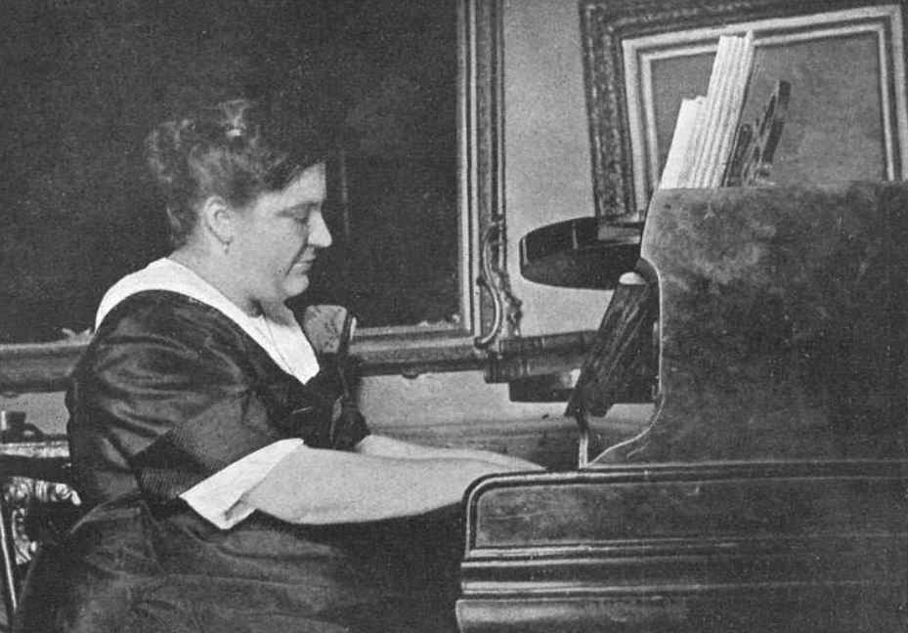
Future work
Complete recordings of all editions.
Alimenting quantitative data analysis
Tools for artistic-research & pedagogy
Publication summer 2025 (June)
Blanche Selva
Echos du temps passé - AR@K symphosium 17-18 March 2025
Notes:
Blanche Selva as music teacher and her legacy. The importance of Bach repertoire in her pedagogical mission.
Building an artistic network through these works.
Works of Bach and Scarlatti were addressing an audience of students and amateurs.
These editors were more explicit in their markings to clearly communicate their style.

Slide 17
Thank you for your attention
Nicholas Cornia
Viktor Lazarov
Notes:
Viktor will play the pieces.

